Slide 1



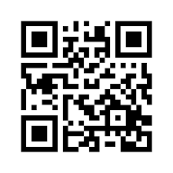

Unlock Your Future at Our Open Day!
Heriot-Watt University Dubai
14th May 2025 | 2:00 PM – 6:00 PM
Step into a world of possibility at Heriot-Watt’s Open Day
Explore Our Campus – Discover world class labs, creative studios, and inspiring learning spaces through guided tours.
Meet the Faculty – Speak directly with professors and academic advisors from your chosen programme.
Admissions Lounge – Get personalised guidance on the application process, entry requirements, and scholarships.
Workshops & Demos – Try out hands-on activities and explore innovations led by our students and researchers.
Global Community – Connect with students from across the world and get a feel for our diverse and welcoming environment.
Scan here
for more info
“Open Day isn’t just a visit – it’s your first step toward a globally connected future.”
Belong. Collaborate. Inspire. Celebrate.

Slide 2


Why Chose Heriot-Watt?
Here’s why thousands of students choose to call Heriot-Watt their academic home.
Globally Recognised Degrees – Our UK-accredited programmes open doors across industries and continents.
Industry-Aligned Programmes – Learn what employers need. Our curriculum evolves with real-world demands.
Student-Centred Learning – Small class sizes, expert mentorship, and flexible learning options.
Future-Ready Campus – Modern labs, innovation hubs, and collaborative spaces built for the future.
Unmatched Support – Career services, wellbeing support, and scholarships—because success should be supported.
A Place to Belong – Be part of a vibrant, inclusive community that celebrates who you are.
Enroll Now!
Belong. Collaborate. Inspire. Celebrate.

